Slide 1
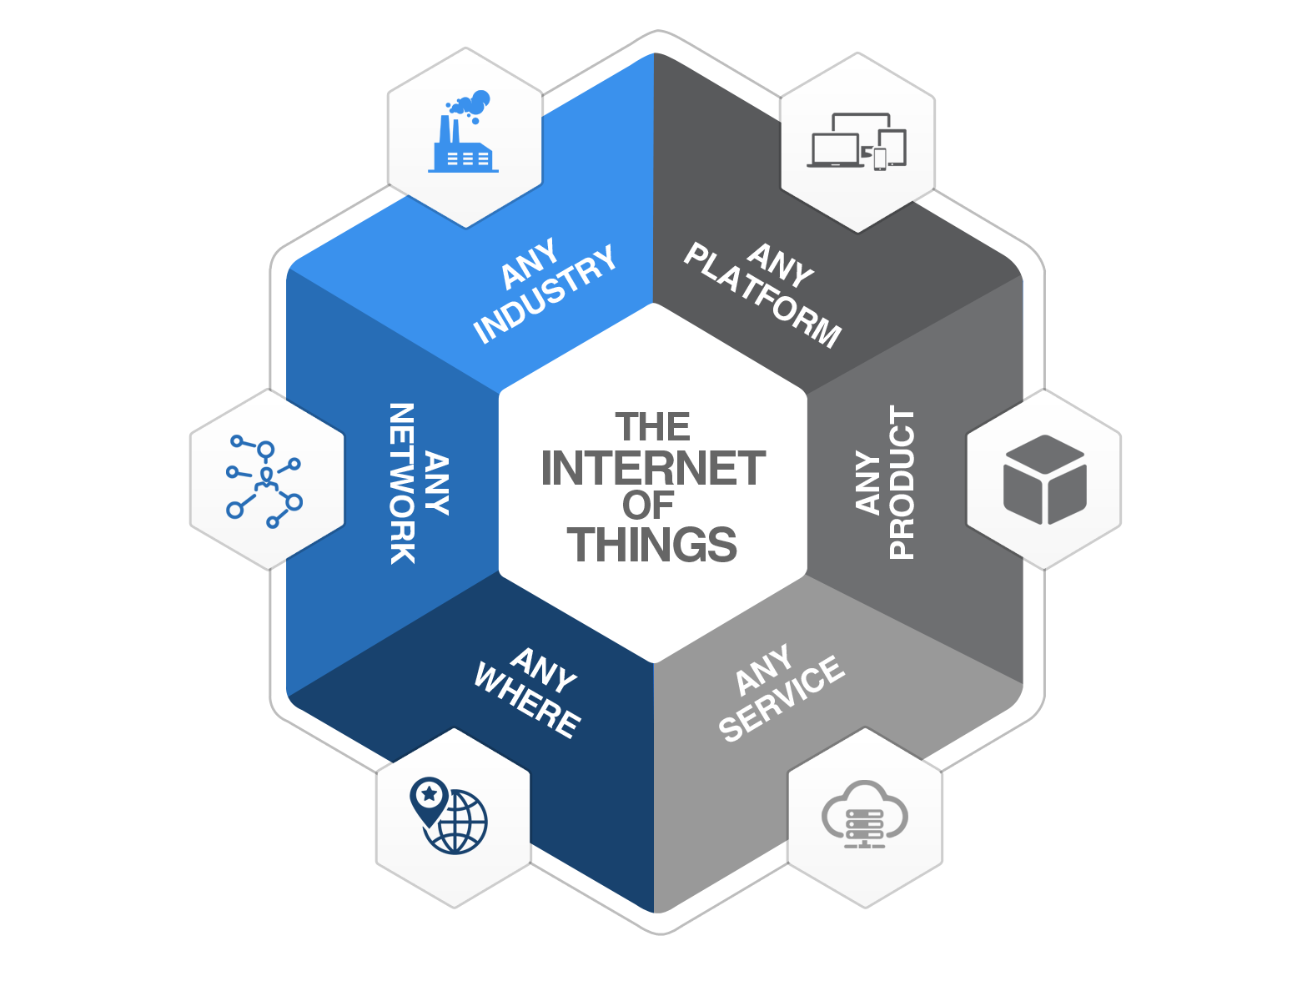

Module 3
CLOUD AND DATA ANALYTICS FOR IOT
Cloud: Types of Cloud - loT with Cloud challenges - Selection of cloud for loT applications - Fog and Edge computing for loT - Cloud security aspects for loT applications. Data Analytics for IoT: Overview of Hadoop ecosystem – MapReduce architecture – MapReduce Job Execution – MapReduce Schedulers. Case study: Internet of Medical Things (IoMT)
Watch this video: Click Here
Module 2

Slide 2

Hadoop Ecosystem
23ITC01-Internet of Things
The Hadoop Ecosystem refers to a collection of open-source projects and tools that work together to provide a comprehensive framework for managing and analyzing large datasets, often referred to as Big Data.
It is built around Hadoop, which is the core technology for distributed storage and processing of massive datasets.
Module-3

Slide 3
23ITC01-Internet of Things
The main components of the Hadoop Ecosystem:
Hadoop Core Components:
Hadoop Distributed File System (HDFS): A distributed file system designed to store large amounts of data across multiple machines. It breaks large files into smaller blocks and stores them across various nodes in a cluster for scalability and fault tolerance.
2.MapReduce: A programming model for processing large data sets in parallel across distributed clusters. It splits the data into chunks and processes them using
two main steps: Map (filtering and sorting) and Reduce (aggregating the results).
Module-3

Slide 4
23ITC01-Internet of Things
Hadoop Ecosystem Tools:
Apache Hive: A data warehouse software built on top of Hadoop for querying and managing large datasets. Hive provides a SQL-like query language, HiveQL, for querying data in a manner similar to traditional relational databases.
Apache HBase: A NoSQL database built on top of HDFS for storing large volumes of data in a columnar format. It is suitable for real-time read/write access to large
datasets.
Apache Pig: A high-level platform for creating MapReduce programs. Pig uses a language called Pig Latin, which simplifies the process of writing complex MapReduce jobs.
Module-3

Slide 5
Key Concepts of Hadoop Ecosystem:
23ITC01-Internet of Things
Data Processing: Tools like MapReduce, Spark, and Pig help process vast amounts of data across distributed nodes.
Data Storage: HDFS is the primary storage system for managing large datasets.
Module-3

Slide 6
Key Concepts of Hadoop Ecosystem:
23ITC01-Internet of Things
Real-Time Processing: Tools like Kaa and Spark Streaming support real-time data ingestion and processing.
Data Ingestion and Integration: Tools like Flume, Sqoop, and Nifi handle the collection, transfer, and integration of
data.
Metadata and Governance: Apache Atlas and other tools manage metadata and governance for large-scale data
systems.
Module-3

Slide 7
What’s Hadoop Used For? Major Use Cases per Cloudera (2012)
23ITC01-Internet of Things
Data processing
Building search indexes
Log processing
“Click Sessionization”
Data processing pipelines
Video & Image analysis
Analytics
Recommendation systems (Machine Learning)
Batch reporting
Real time applications (“home of the brave”)
Data Warehousing
Module-3

Slide 8

HDFS
23ITC01-Internet of Things
Google File System (GFS) cited as the original concept
Certain common attributes between GFS & HDFS
Pattern emphasis: Write Once, Read Many
Sound familiar?
Remember WORM drives? Optical jukebox library? Before CDs (CD-R)
Back when dirt was new… almost…
WORM optical storage was still about greater price:performance at larger storage volumes vs. the prevailing [disk] technology – though still better p:p than The Other White Meat of the day, Tape!
Very Large Files: One file could span the entire HDFS
Commodity Hardware
2 socket; 64-bit; local disks; no RAID
Co-locate data and compute resources
Module-3

Slide 9
HDFS: What It’s Not Good For
23ITC01-Internet of Things
Many, many small files
Scalability issue for the namenode (more in a moment)
Low Latency Access
It’s all about Throughput (N=XR)
Not about minimizing service time (or latency to first data read)
Multiple writers; updates at offsets within a file
One writer
Create/append/rename/move/delete - that’s it! No updates!
Not a substitute for a relational database
Data stored in files, not indexed
To find something, must read all the data (ultimately, by a MapReduce job/tasks)
Selling SAN or NAS – NetApp & EMC need not apply
Programming in COBOL
Selling mainframes & FICON
Module-3

Slide 10

HDFS Concepts & Architecture
23ITC01-Internet of Things
Core architectural goal: Fault-tolerance in the face of massive parallelism (many devices, high probability of HW failure)
Monitoring, detection, fast automated recovery
Focus is batch throughput
Hence support for very large files; large block size; single writer, create or append (no update) and a high read ratio
Master/Slave: Separate filesystem metadata & app data
One NameNode manages the filesystem and client access
All metadata - namespace tree & map of file blocks to DataNodes - stored in memory and persisted on disk
Namespace is a traditional hierarchical file organization (directory tree)
DataNodes manage locally attached storage (JBOD, no RAID)
Not layered on or dependent on any other filesystem
Module-3

Slide 11
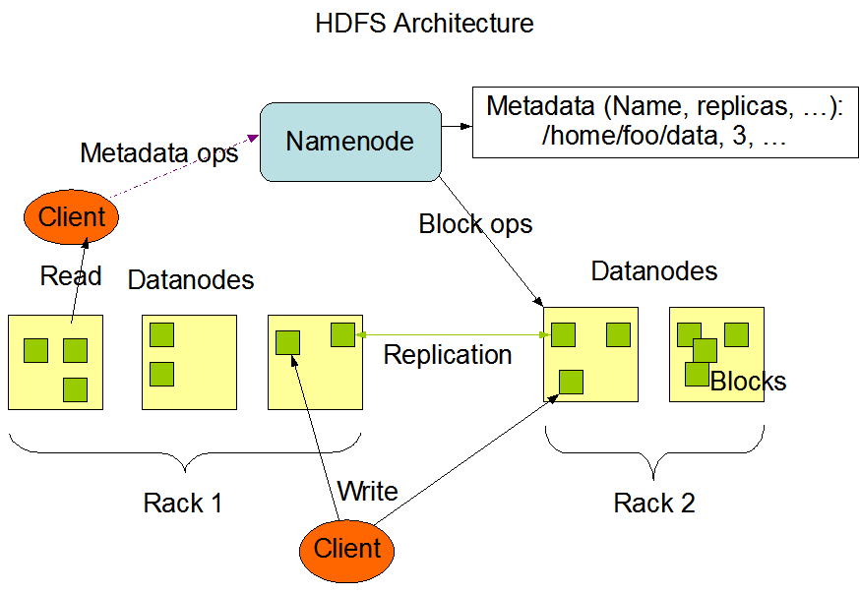
23ITC01-Internet of Things
http://hadoop.apache.org/common/docs/current/hdfs_design.html
Module-3

Slide 12
HDFS Concepts & Architecture
23ITC01-Internet of Things
Block-oriented
Not your father’s block size: 64 MB by default
Block size selectable on a file-by-file basis
What if an HDFS block was 512 bytes or 4KB instead of 64 MB?
Metadata would be 128K (131,072) times or 16K (16,384) times larger, impacting memory on NameNode and potentially limiting the total HDFS storage size in the cluster
Total storage also sensitive to total number of files in HDFS
All blocks in a file are the same size, except the last block
Large block size minimizes seek time
Approaches disk spiral transfer rate ~100 MB/sec
Disk read-ahead may further minimize track to track seek time
High aggregate file read bandwidth, # disks/node X 100 GB/sec
Divides incoming files into blocks, storing them redundantly across DataNodes in the cluster: Replication for fault-tolerance
Replication Factor per-file
Location of block replicas can change over time
Module-3

Slide 13

HDFS
23ITC01-Internet of Things
Built with Java
Typically runs on a Linux distribution
But it’s Java…
Module-3

Slide 14
NameNode
22IT602-Internet of Things
Is a SPOF, single point of failure
Metadata persisted in the file FsImage
Changes since last checkpoint logged separately in a transaction log called the EditLog
Both files stored in NameNodes’s local filesystem
Availability: Redundant copies to NAS or other servers
Counter-intuitive:
Checkpoint done only at NameNode startup
EditLog read to update FsImage; FsImage mapped into memory; EditLog truncated; ready to rock!
The NameNode does not directly call DataNodes but piggy-backs instructions in its replies to DataNodes’ heartbeat
Replicate blocks to other nodes (pipeline approach)
Remove block replicas (load balancing)
Restart (re-register, re-join cluster) or shutdown
Send a block report NOW
Module-3

Slide 15
DataNodes
22IT602-Internet of Things
A block replica is made up of 2 files on a DataNode’s local file system
The data itself
Block metadata
Block checksum and generation timestamp
At startup the DataNode connects to the NameNode & performs a handshake to verify ID and version
Shutdown if either does not match: Prevent corruption
Nodes cannot “register” with NameNode; i.e., join the cluster unless they have a matching ID
Blocks consume only the space needed
Hadoop optimizes for full blocks until the last block of the file is written
Module-3

Slide 16
DataNodes (cont’d)
22IT602-Internet of Things
Sends a block report to the NameNode about all block replicas it contains, at DataNode “startup” and hourly
Sends heartbeat to NameNode @ 3 sec intervals (default)
10 minute timeout, DataNode removed by NameNode and new replicas of its blocks scheduled for creation on other DataNodes
Heartbeat also contains info used by NameNode’s storage allocation and load balancing algorithms
Module-3

Slide 17
Back to the NameNode
22IT602-Internet of Things
Filesystem metadata is persisted in the file “FsImage”
Changes since last checkpoint logged separately in a transaction log called the “EditLog”
Both files stored in NameNodes’s local filesystem
Availability: Redundant copies to NAS or other servers
Counter-intuitive:
Checkpoint done only at NameNode startup
Replay EditLog to update FsImage; FsImage mapped into memory; EditLog truncated; ready to rock!
Module-3

Slide 18
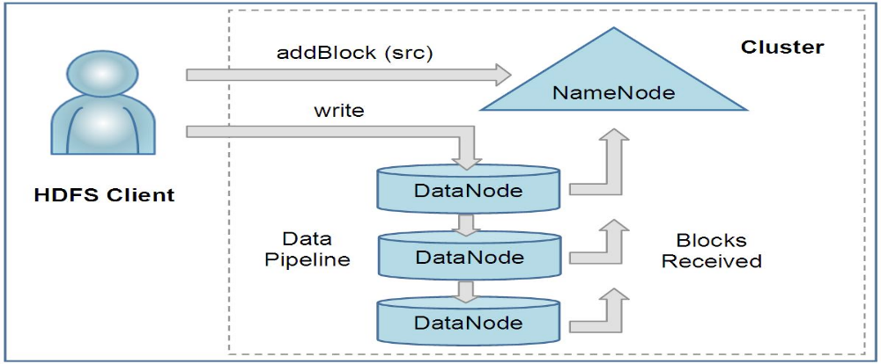
Client Read & Write
22IT602-Internet of Things
Client read request first contacts the NameNode for locations of file data blocks; reads blocks from closest DataNode(s)
Uses block checksum to detect corruption, a common problem in clusters of 100s-1,000s of nodes and disks
Client write operation sends path to NameNode; requests NameNode to select Replication Factor number of DataNodes to host block replicas; writes data to DataNodes in serial pipeline manner (more in a moment)
File create:
Module-3

Slide 19
Client Write (cont’d)
22IT602-Internet of Things
Write Pipeline
Data bytes pushed to the pipeline as a sequence of packets
Client buffers bytes until a packet buffer fills (64KB default) or until file is closed, then packet is pushed into the pipeline
Client calculates & sends checksum with block
Recall that data and metadata (incl. checksum) are stored separately on DataNode
Asynchronous I/O
Client does not wait for ACK to packet by DataNode, continues pushing packets
Limit to the # of outstanding packets = “packet window size” of client
i.e., the queue size (N=XR)
Data visible to new reader at file close or using hflush call
Module-3

Slide 20
HDFS Key Points
22IT602-Internet of Things
Locality and High Performance
HDFS is atypical of conventional non-distributed file systems in that its API exposes the location of a file’s blocks, with major implications
Frameworks like MapReduce can thus schedule a task to execute where the data is located
Send computation to the data, not the other way around
Reduces network infrastructure costs, reduces elapsed time
Highest read performance when a task executes with data on local disks
Point-to-point SAS/SATA disks, no shared bus, a key technology enabler
Massive price : performance benefit over SAN storage
Supports application per-file replication factor (default 3)
Improves fault tolerance
Increases read bandwidth for heavily accessed files
Module-3

Slide 21
Typical Hadoop Node
22IT602-Internet of Things
Dual socket 1U/2U rack mount server
Internal disk requirement negates use of blades
Quad core CPUs >2 GHz
16-24 GB memory
4 to 6 data disks @ 1TB
Performance & economics target for heavily queried data, busy processors
Use cases focusing on long-term storage might deploy a DL370 5U form factor with 14 internal 3.5” disks
1 GbE NIC
Linux
Module-3

Slide 22

Hadoop MapReduce
22IT602-Internet of Things
Software framework for “easily” writing applications that process vast (multi-TB) amounts of data in parallel on very large clusters of commodity hardware with reliability and fault-tolerance
A MapReduce job normally divides the input data into separate chunks which are then processed in parallel by Map tasks. The framework guarrantees Map output is sorted for input to Reduce
The sorted outputs are inputs to the Reduce tasks
Input and output are stored in HDFS
Framework performs task scheduling; task monitoring & re-execution of failed tasks
Massive aggregate cluster bandwidth
# nodes X # disks X ~100 MB/sec
Module-3

Slide 23
Language Support
22IT602-Internet of Things
Java (native)
Streaming
Any language supporting Unix STREAMS interface
Read from stdin, write to stdout
Redirection as usual
Highly suited to text processing
Line by line input
Key-value pair output of Map program written as tab-delimited line to stdout
MapReduce Framework sorts the Map task output
Reduce function reads sorted lines from stdin
Reduce finally writes to stdout
Python; Perl; Ruby; etc.
Pipes
The C++ interface for MapReduce
Sockets interface (not streams, not java native interface JNI)
Module-3

Slide 24
Hadoop MapReduce
22IT602-Internet of Things
Master/Slave architecture
One master Jobtracker in the cluster
One slave Tasktracker per DataNode
Jobtracker
Schedules a job’s constituent tasks on slaves
Monitors tasks, re-executes upon task failure
Tasktracker executes tasks by direction of the Jobtracker
Module-3

Slide 25

Hadoop MapReduce Job Execution
22IT602-Internet of Things
Client MapReduce program submits job through JobClient.runJob API
Job Client (in client JVM on client node) sends request to JobTracker (on JobTracker node), which will coordinate job execution in the cluster
JobTracker returns Job ID
JobClient calculates splits of input data
JobClient “fans the job out” to multiple systems
Copies program components (Java jar, config file) and calculated input data splits to JobTracker’s filesystem. Write (default) 10 copies of this to 10 JobTrackers (recall JobTracker is one per DataNode)
JobTracker inserts job into its queue for its scheduler to dequeue and init
Init: Create job object to represent tasks it executes, and track task progress/status
JobClient informs JobTracker that job is ready to execute
JobTracker creates list of tasks to run
Retrieves (from HDFS) the input data splits computed by JobClient
Creates one Map task per data split
Module-3

Slide 26
TaskTracker
22IT602-Internet of Things
TaskTrackers communication with JobTracker
Default loop, sends periodic heartbeat message to JobTracker
Tasktracker is alive
Available (or not) to run a task
JobTracker sends task to run in heartbeat response message if TaskTracker available
TaskTrackers have limited queue size for Map and for Reduce tasks
Queue size mapped to # cores & physical memory on TaskTracker node
TaskTracker scheduler will schedule Map tasks before Reduce tasks
Copies jar file from HDFS to TaskTracker filesystem
Unwinds jar file into a local working directory create for task
Creates TaskRunner to run the task
TaskRunner starts a JVM for each task
Separate JVM per task isolates TaskTracker from user M/R program bugs
Module-3

Slide 27
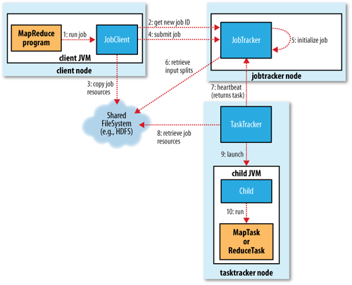
Module-3

Slide 28
TaskTracker
22IT602-Internet of Things
TaskTracker per-task JVM (children) communicate to parent
Status, progress of each task, every few seconds via “umbilical” interface
Streaming interface communicates with process via stdin/stdout
MapReduce jobs are long-running
Minutes to hours
Status and progress important to communicate
State: Running, successful completion, failed
Progress of map & reduce tasks
Job counters
User-defined status messages
Task Progress: How is this defined?
Input record read (Map or Reduce)
Output record written
Set status description on Reporter, increment Reporter counter, call to Reporter progress() method
Module-3

Slide 29
Job Completion
22IT602-Internet of Things
JobTracker receives last task’s completion notification
Changes job status to “successful”
Can send HTTP job notification message to JobClient
JobClient learns of success at its next polling interval to JobTracker
Sends message to user
JobTracker performs cleanup, commands TaskTrackers to cleanup
Module-3

Slide 30
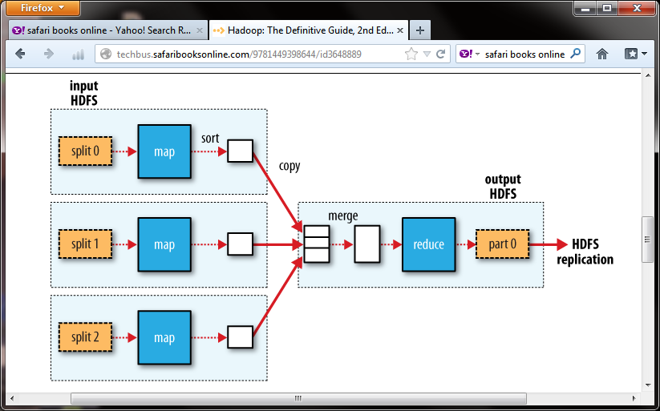
Example Job & Filesystem Interaction Multiple Map tasks, one Reduce task Map reads from HDFS, writes to local FS Reduce reads from local FS, writes to HDFS
22IT602-Internet of Things
Module-3

Slide 31
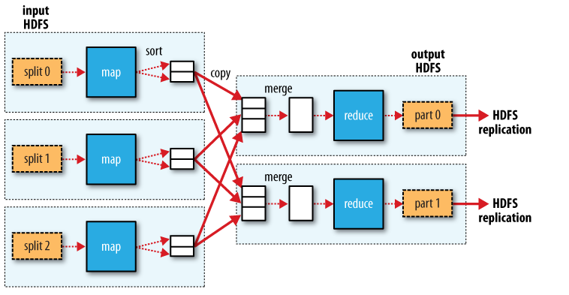
Example # Job & Filesystem Interaction Multiple Map tasks, Two Reduce tasks Each Reduce writes one partition per Reduce task to HDFS
22IT602-Internet of Things
Module-3

Slide 32

22IT602-Internet of Things
Apache Hive!
Data warehouse system providing structure onto HDFS
SQL-like query language, HiveQL
Also supports traditional map/reduce programs
Popular with data researchers
Bitly; LinkedIn to name two
Originated & developed at Facebook
Module-3

Slide 33

22IT602-Internet of Things
Apache Pig!
High-level language for data analysis
Program structure “…amenable to substantial parallelization”
“Complex tasks comprised of multiple interrelated data transformations are explicitly encoded as data flow sequences, making them easy to write, understand, and maintain.”
Popular with data researchers who are also skilled in Python as their analysis toolset and “glue” language
Originated & developed at Yahoo!
Module-3

Slide 34

22IT602-Internet of Things
Apache HBase!
Realtime, Random R/W access to Big Data
Column-oriented
Modeled after Google’s Bigtable for structured data
Massive distributed database layered onto clusters of commodity hardware
Goal: Very large tables, billions of rows X millions of columns
HDFS underlies HBase
Originally developed at Powerset; acquired by Microsoft
Module-3

Slide 35

22IT602-Internet of Things
Apache Zookeeper!
Goal: Provide highly reliable distributed coordination services via a set of primitives for distributed apps to build on
“Because Coordinating Distributed Systems is a Zoo” (!)
Common distributed services notoriously difficult to develop & maintain on an application by application basis
Centralized distributed synchronization; group services; naming; configuration information
High performance, highly available, ordered access
In memory. Replicated. Synchronization at client by API
Originated & developed at Yahoo!
Module-3

